Slide 1
PA 397C Program Evaluation
JEFF DENNING

Slide 2
Outline
Goals of the Course
About Me
About You
Administrative Stuff
How to Succeed in this Class
Rubin Causal Framework

Slide 3
Goals of Course

Slide 4
What is Program Evaluation?
This course is where statistics becomes useful
IEM taught you some basic tools, but did you feel like you could apply those to real world problems? The hope is that after this class you will be able to do that
The focus of this class is practical–how can we know the effects of a given policy
You will learn the modern toolkit of program evaluation
You will write a paper that uses this toolkit.

Slide 5
Learning Outcomes
Demonstrate an understanding of the assumptions underlying commonly used empirical approaches for the identification of causal effects, including: Ordinary Least Squares, Matching, Interrupted Time Series, Differences in Differences, Fixed Effects, Instrumental Variables, and Regression Discontinuity
Read and understand contemporary academic literature in program evaluation. Students will provide written evaluations of selected academic papers, including a clear description and critique of the empirical methods used.
Apply modern empirical methods using data analysis exercises.
Complete a research project in which they identify a question, assemble a dataset, thoughtfully apply appropriate empirical methods, and clearly describe their methodology, assumptions, and findings.

Slide 6

Background
Hometown: South Jordan, UT
Education:
BA/BS Econ/Math, BYU
MS/PhD Econ, UT Austin
Employment
BYU Economics 2015-2023
ND Economics 2023-2025
UT LBJ & COE 2025-

Slide 7
Research Areas
Education
The effect of financial aid/tuition/student loans on enrollment, major, graduation, earnings, and prices.
The effect of your rank among peers on future outcomes
Why college graduation rates have increased?
The effects on information “nudges” on student outcomes
Grade Inflation
DUIs

Slide 8
You
Where are you from?
What is your background/policy interest?
What do you hope to get from the class?
Hobbies/interests/favorite restaurant in Austin?

Slide 9
Administrative Stuff

Slide 10
Website
I will use my website jeffdenning.com/teaching as the repository for class notes, problem sets, and syllabus.
You will turn in assignments on Canvas which has due dates etc. that match the syllabus

Slide 11
Laptops/Electronics
You may not use laptops, tablets, or any other electronic devices during class.
The reason is that there is good (and increasing evidence) that banning laptops in classrooms helps students learn more
I will exceptions in the event of a disability, please contact me if you have questions
I will make exceptions if we use Stata in class and will inform you the class period prior

Slide 12
Quizzes and Exams
There will be 4 quizzes based on discussions in class and reading. I will drop 1 quiz

Slide 13
Text Book
Mastering 'Metrics: The Path from Cause to Effect by Joshua D. Angrist and Jörn-Steffen Pischke
This is actually required—we will read nearly all of it for class
Another reference: https://mixtape.scunning.com/

Slide 14
Syllabus
Grade breakdown:
Homework 10 %
Class Participation 5 %
Quizzes 25 %
Midterm 25 %
Term Paper 35 %
(15% final paper, 15% presentation, 5% rough draft)
There may be a subjective curve

Slide 15
Homework
There will be 5 problem sets throughout the semester. 1 will be dropped.
You are encouraged to work in small groups (no larger than 3) and turn in 1 assignment.
Assign Groups?
Late homework will not be accepted
Grading will be based on completion, answer keys will be posted after the homework is due.

Slide 16
Stata
You will need Stata for this class.
A few options
6 month license of Stata BE, $48. This will be easiest for homework and project
You can use the StatsApps Server (see syllabus)
Computer lab in SRH 3.200
Kathryn McArdle will have Stata workshops
Th Jan 22 2-2:30 in 3.245
F Jan 23 12:30-2 in 3.122

Slide 17
Exams
There will be a midterm in class on Mar 31.
An example from a previous class is posted on my website
That was a take home version, you will do an in class version.

Slide 18
Paper
You will be expected to generate a term paper. This paper should be written in groups of 2
The paper is to be no more than 10 pages long (not including tables)
You will present the idea for your paper in March
A rough draft will be due in April 7
You will present your papers in April 14
You will have a consultation with me about your papers in December
Final drafts will be due April 21

Slide 19
Class Participation
You will be expected to contribute to the discussion by doing the reading/discussing them
Completing the midcourse evaluation
Abiding by electronics policy.

Slide 20
AI Policy
You can use AI however you would like
This can include for coding (except when there are explicit steps you need to take etc)
I have changed allocation of points as a result (e.g. more emphasis on presentation)
Open to feedback/discussion on this

Slide 21
How to Succeed in this Class

Slide 22
Study Tips
You need to read the assigned reading
This will help you and help the class because this class will be discussion based.
I have a list of questions to answer for every paper we read. After our class discussion, you should be able to answer these questions.
Get started on your project ASAP.

Slide 23
Resources Available to You
Office Hours:
My office hours
M 10-11, T *1-2
How to look up papers, read papers

Slide 24
Why Program Evaluation?

Slide 25
If you got to pick a policy to implement, what would it be?
Why?

Slide 26
Imagine you are working in a setting where you advocate for policy
Could be for a legislator, at a government agency, for an advocacy group.
How might you pick which policies you advocate for?
What are important criteria?

Slide 27
Criteria
What effect will the policy have?
Who will it affect?
Does it affect some groups differently than others?
How much does it cost?
How hard will it be to implement?
Which of these is most important?

Slide 28
Why causal effects are so important:
Adams Scholarship: A Case Study
College costs are high and many policymakers are concerned about the rising price of college.
Group activity–come up with a proposal to reduce college costs. You work for the governor’s office, this has to be “practical,” can look to other states for guidance

Slide 29
Case Study: Adams Scholarship

Slide 30
Adams Scholarship
In 2004, Massachusetts Governor Mitt Romney proposed (and implemented) the “Adams Scholarship”
“I want our best and brightest to stay right here in Massachusetts”
This waived tuition at MA public universities for students who scored in top 25% of state standardized test in district and had to have 1 score that was “advanced
Had to be Mass. public high school student

Slide 31
What are your predictions for how this affected student enrollment and completion?

Slide 32
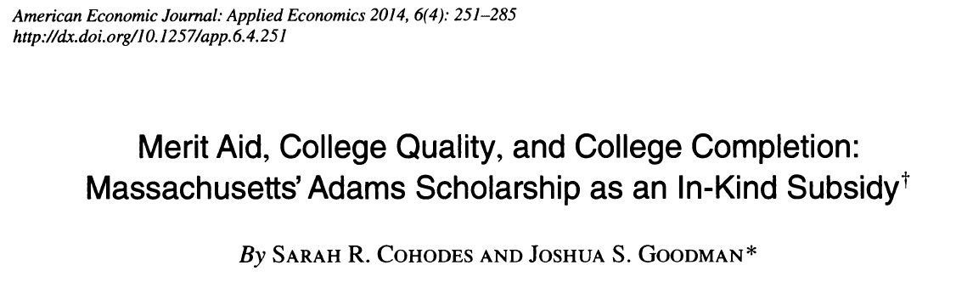
This program was rigorously evaluated, so we don’t have to guess

Slide 33
How?
The authors used data from Massachusetts Department of Elementary and Secondary education and the national student clearinghouse
They also used a technique we will discuss in much more detail later in the semester

Slide 34
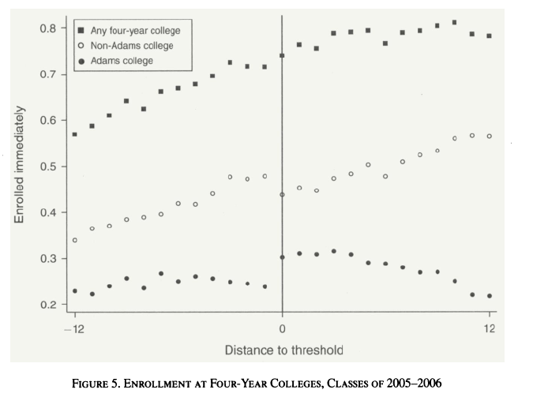
What Happened to Enrollment?

Slide 35
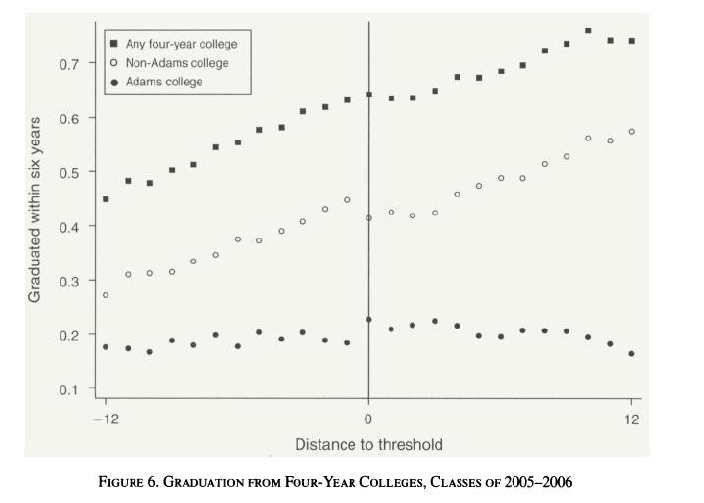
Graduation?

Slide 36
Surprise!
Students attended the in state public universities, but they were less likely to graduate from any college
Not what policymakers hoped for (or what you might predict)
Why was this?

Slide 37
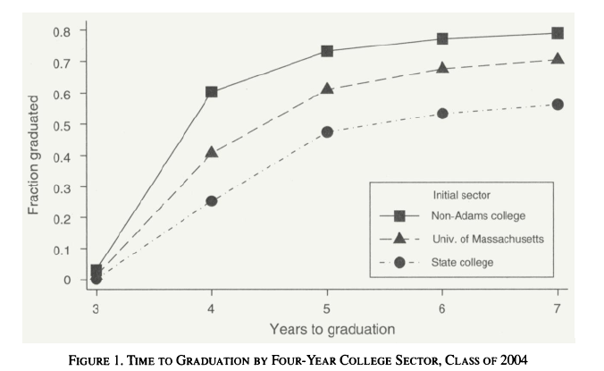
“Adams” Colleges had Lower Graduation Rates

Slide 38
Adams covered tuition only–not fees
Tuition was ~$1,400 Fees were about ~$13,000
Future years clarified that fees were not included.

Slide 39
What should policymakers do now?
Probably stop the scholarship! Or at least modify it in some way
However, the scholarship still exists, and is largely unchanged

Slide 40
This is a simple, but prominent example of why program evaluation matters
You cannot conduct good policy if you do not know the effects of that policy.
There are often unintended consequences or smaller effects than anticipated
Given scarce funding, we should fund programs that work

Slide 41
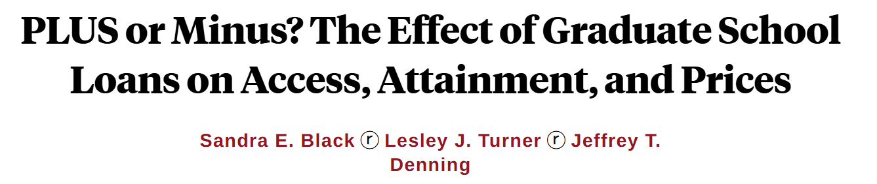
One closer to home, Grad PLUS Loans

Slide 42
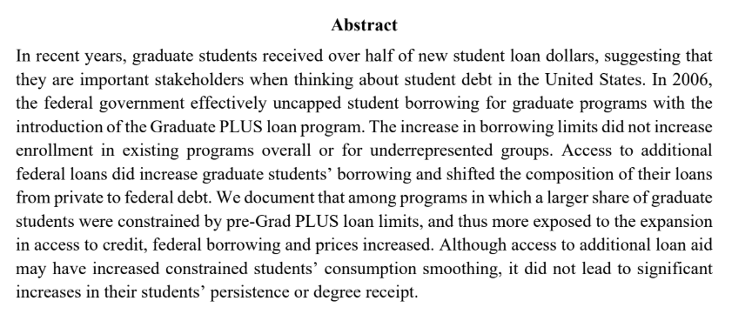
Grad PLUS Loans

Slide 43
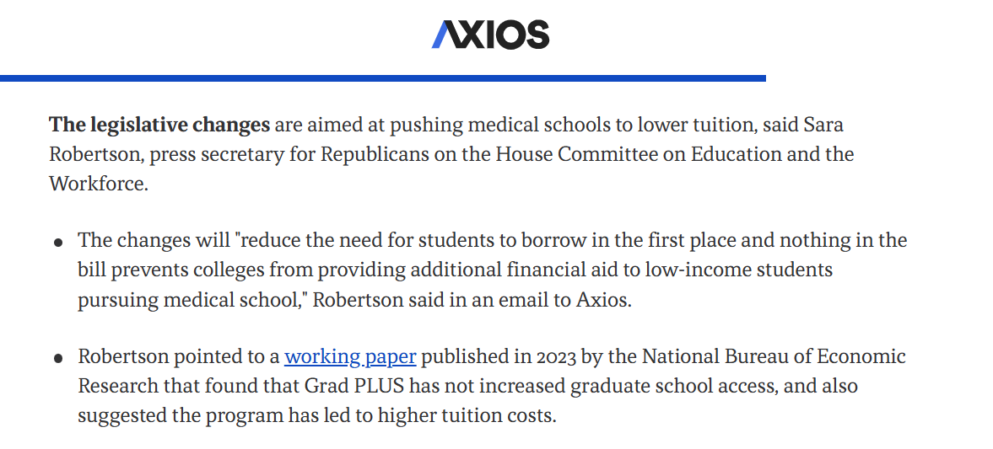

Slide 44
Should Policymakers only Consume Evidence? Or should they produce it?
Would you be supportive of building evaluation into your implemented policy?
What would this require?
ND LEO

